Slide 1
Basis and Dimension Ahmad Parsian
Mini Lesson on
Basis and Dimension
(of a Vector Space)
by
Ahmad Parsian
at
DigiPen Institute of Technology

Slide 2
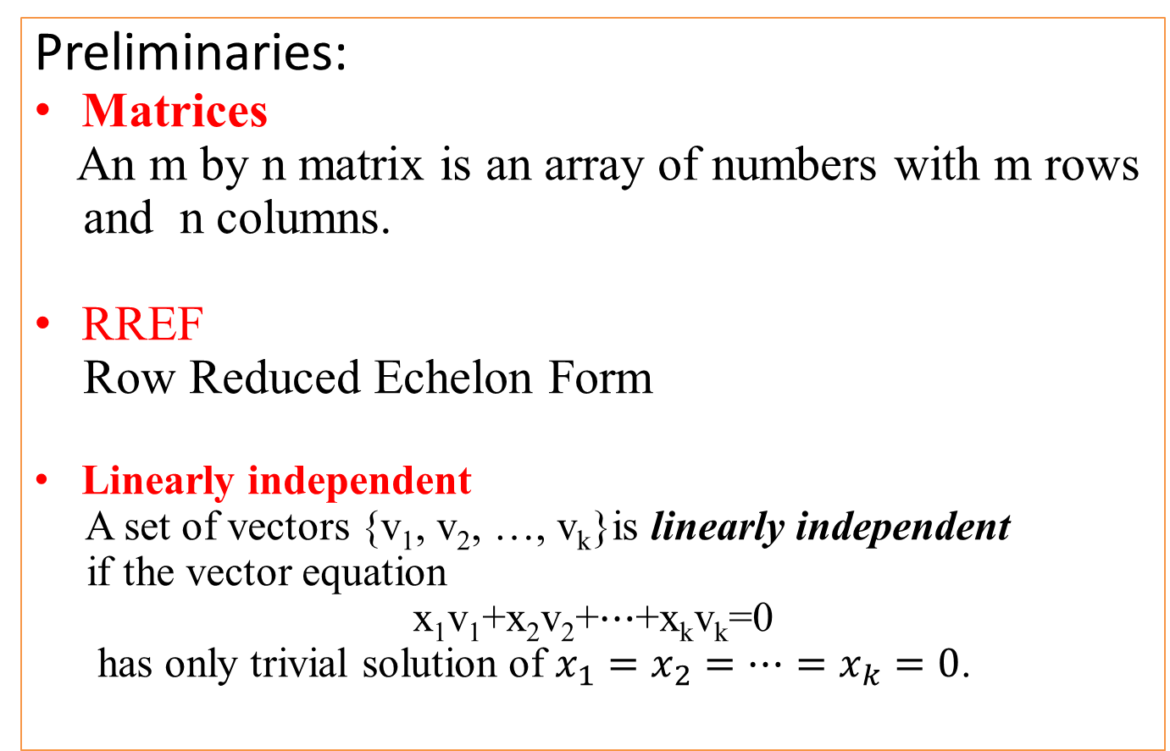
Basis and Dimension Ahmad Parsian
Preliminaries:
Matrices
An m by n matrix is an array of numbers with m rows
and n columns.
RREF
Row Reduced Echelon Form
Linearly independent
A set of vectors {v₁, v₂, …, v_{k}}is linearly independent
if the vector equation
x₁v₁+x₂v₂+⋯+x_{k}v_{k}=0
has only trivial solution of $x_{1}=x_{2}=…=x_{k}=0$.

Slide 3
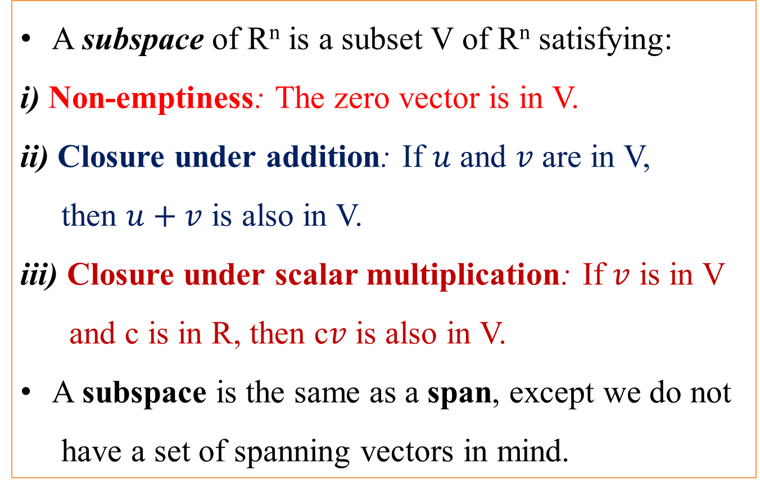
Basis and Dimension Ahmad Parsian
A subspace of R^{n} is a subset V of R^{n} satisfying:
i) Non-emptiness: The zero vector is in V.
ii) Closure under addition: If $u$ and $v$ are in V,
then $u+v$ is also in V.
iii) Closure under scalar multiplication: If $v$ is in V
and c is in R, then c$v$ is also in V.
A subspace is the same as a span, except we do not
have a set of spanning vectors in mind.

Slide 4
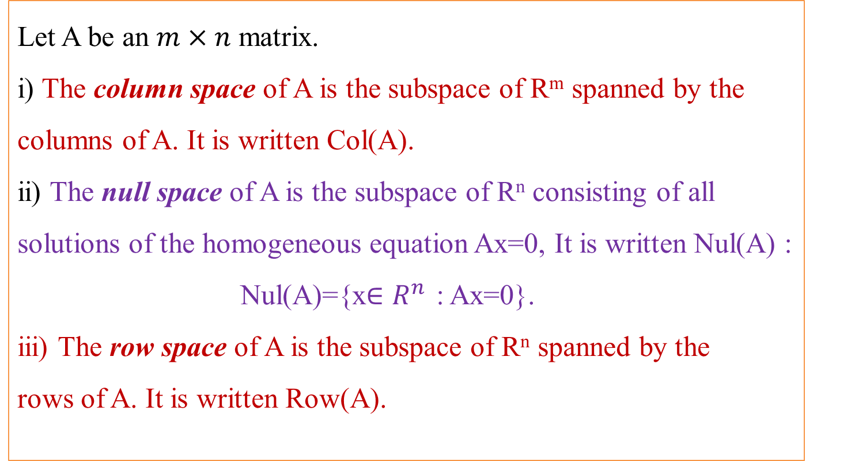
Basis and Dimension Ahmad Parsian
Let A be an $m×n$ matrix.
i) The column space of A is the subspace of R^{m} spanned by the columns of A. It is written Col(A).
ii) The null space of A is the subspace of R^{n} consisting of all solutions of the homogeneous equation Ax=0, It is written Nul(A) :
Nul(A)={x$∈R^{n}$ : Ax=0}.
iii) The row space of A is the subspace of R^{n} spanned by the rows of A. It is written Row(A).

Slide 5
Basis and Dimension Ahmad Parsian
Objectives:
Understand the definition of a basis of a subspace.
Understand the definition of the dimension of a subspace.
Understand the basis theorem.
Recipes: basis for a column space, basis for a null space, basis of a span.
Theorem: basis theorem.
Essential vocabulary words: basis, dimension

Slide 6
Basis and Dimension Ahmad Parsian
Basis of a Subspace
There are infinitely many choices of spanning sets for a nonzero subspace; to avoid redundancy, usually it is most convenient to choose a spanning set with the minimal number of vectors in it. This is the idea behind the notion of a basis.

Slide 7
Basis and Dimension Ahmad Parsian
Definition (of Basis)
Let V be a subspace of R^{n}.
A basis of V is a set of vectors {v₁, v₂, …, v_{k}}in V such that:
1)V=Span{v₁, v₂, …, v_{k}}, and
2) the set {v₁, v₂, …, v_{k}}is linearly independent.

Slide 8
Basis and Dimension Ahmad Parsian
Notice that,
If {v₁, v₂, …, v_{k}}is a basis of a subspace V, then no proper subset of {v₁, v₂, …, v_{k}} will span V:
it is a minimal spanning set.
Any subspace admits a basis and uniquely determine any vector in V.
A nonzero subspace has infinitely many different bases, but
they all contain the same number of vectors.
Any two bases of a subspace have the same number of vectors.

Slide 9
Basis and Dimension Ahmad Parsian
Definition (of Dimension)
Let V be a subspace of R^{n}.
The number of vectors in any basis of V is called the
dimension of V and is written as dimV.

Slide 10
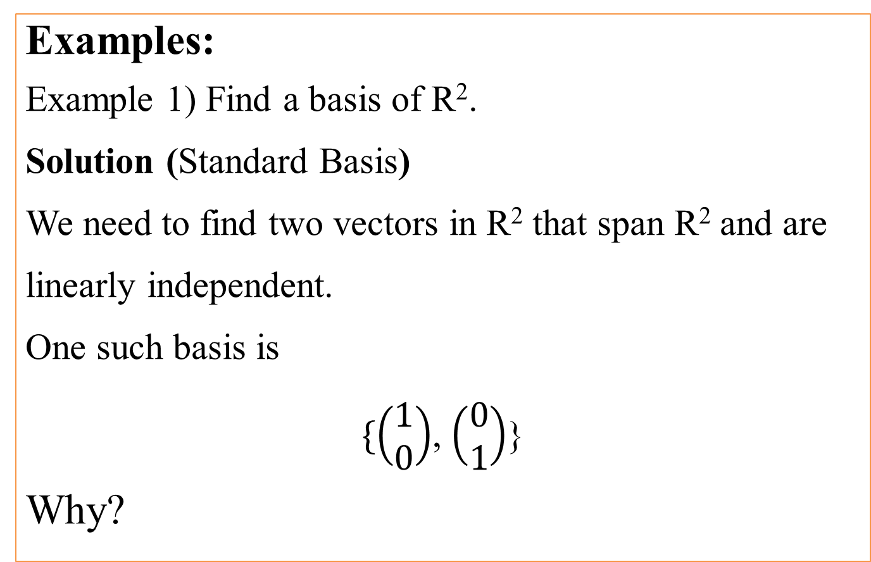
Basis and Dimension Ahmad Parsian
Examples:
Example 1) Find a basis of R².
Solution (Standard Basis)
We need to find two vectors in R² that span R² and are linearly independent.
One such basis is
$\{\left(\begin{matrix}1 \\ 0\end{matrix}\right)$, $\left(\begin{matrix}0 \\ 1\end{matrix}\right)$}
Why?

Slide 11
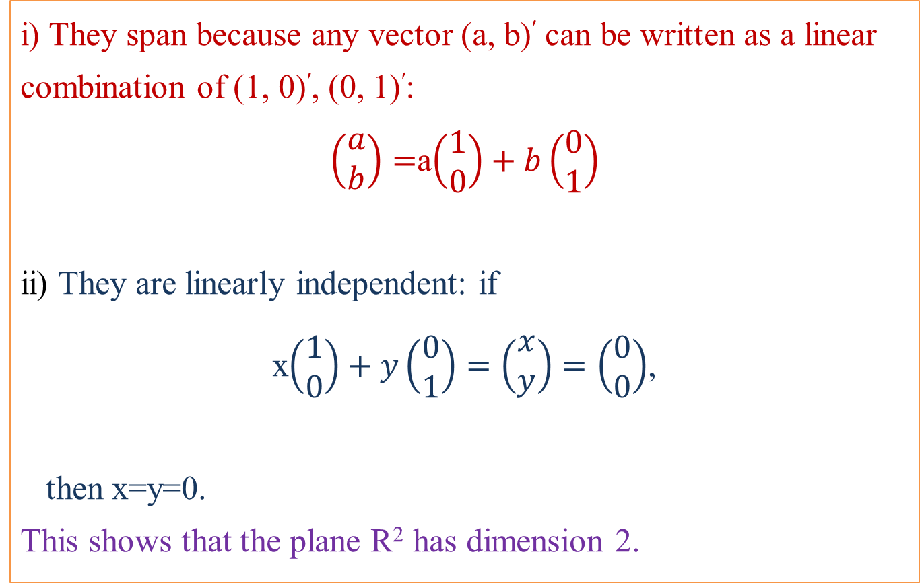
Basis and Dimension Ahmad Parsian
i) They span because any vector (a, b)$\text{′}$ can be written as a linear combination of (1, 0)′, (0, 1)′:
$\left(\begin{matrix}a \\ b\end{matrix}\right)=$a$\left(\begin{matrix}1 \\ 0\end{matrix}\right)+b\left(\begin{matrix}0 \\ 1\end{matrix}\right)$
ii) They are linearly independent: if
x$\left(\begin{matrix}1 \\ 0\end{matrix}\right)+y\left(\begin{matrix}0 \\ 1\end{matrix}\right)=\left(\begin{matrix}x \\ y\end{matrix}\right)=\left(\begin{matrix}0 \\ 0\end{matrix}\right)$,
then x=y=0.
This shows that the plane R² has dimension 2.

Slide 12
Basis and Dimension Ahmad Parsian
We can show that any set of 2 vectors {v₁, v₂}in R² that are linearly independent is a basis of R²
e.g.: {(1, 0)′, (1, 1) ′}, {(1, 2) ′, (2, 1)′}, …

Slide 13
Basis and Dimension Ahmad Parsian
Example 2) Find a basis for R^{n}
One can shows exactly as in the Example 1 that the standard coordinate vectors,
e₁= (1, 0, …, 0)′, e₂= (0, 1, …, 0)′, …, e_{n}= (0, …0,1)′
form a basis for R^{n}.
This is sometimes known as the standard basis.
In fact, dim R^{n} is n.
We can show that any set of n vectors {v₁, v₂, …, v_{n}}in R^{n} that are linearly independent is a basis of R^{n}.

Slide 14
Basis and Dimension Ahmad Parsian
Example 3) Let V= {(x, y, z)′ : x+3y+z = 0} and
B = { (-3, 1, 0)′, ( 0, 1, -3)′}.
i) Verify that V is a subspace, and
ii) Show that B is a basis for V.

Slide 15
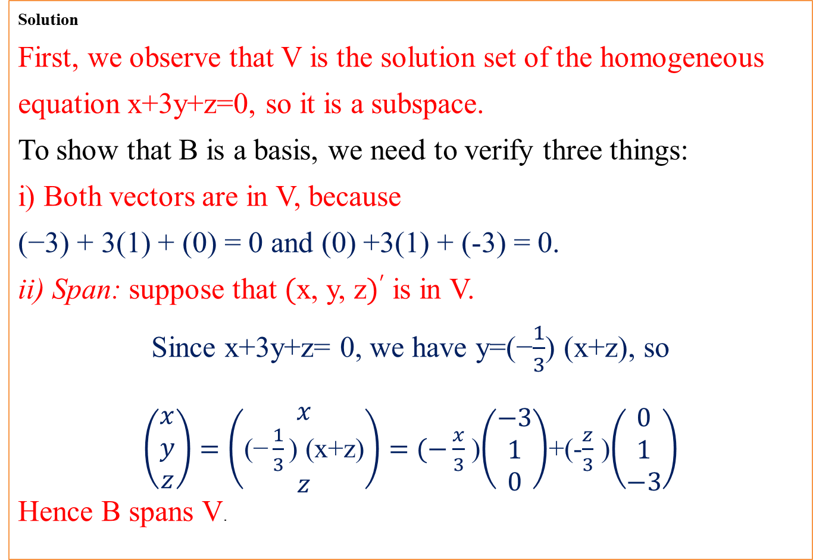
Basis and Dimension Ahmad Parsian
Solution
First, we observe that V is the solution set of the homogeneous equation x+3y+z=0, so it is a subspace.
To show that B is a basis, we need to verify three things:
i) Both vectors are in V, because (−3) + 3(1) + (0) = 0 and (0) +3(1) + (-3) = 0.
ii) Span: suppose that (x, y, z)′ is in V.
Since x+3y+z= 0, we have y=(−$\frac{1}{3}$) (x+z), so $\left(\begin{matrix}x \\ y \\ z\end{matrix}\right)=\left(\begin{matrix}x \\ \text{(−}\frac{1}{3}\text{) (}\text{x}\text{+}\text{z}\text{)} \\ z\end{matrix}\right)=(−\frac{x}{3}$ )$\left(\begin{matrix}−3 \\ 1 \\ 0\end{matrix}\right)$+(-$\frac{z}{3}$ )$\left(\begin{matrix}0 \\ 1 \\ −3\end{matrix}\right)$
Hence B spans V.

Slide 16
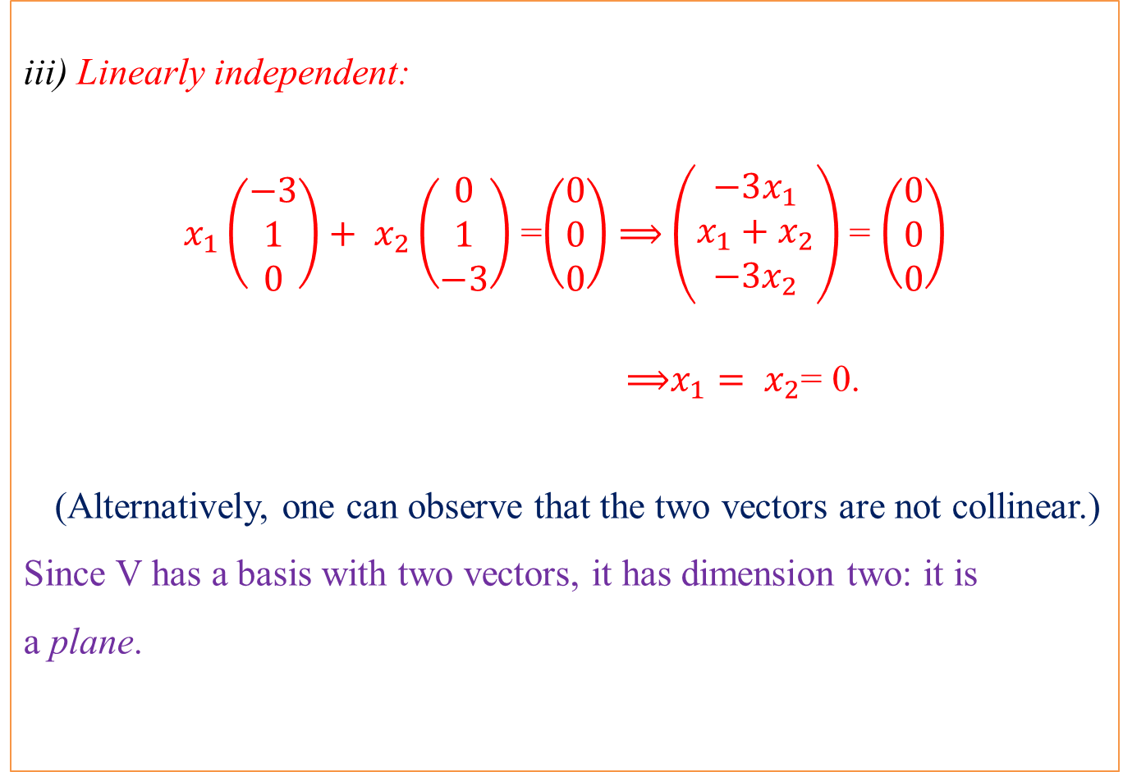
Basis and Dimension Ahmad Parsian
iii) Linearly independent:
$x_{1}\left(\begin{matrix}−3 \\ 1 \\ 0\end{matrix}\right)+ x_{2}\left(\begin{matrix}0 \\ 1 \\ −3\end{matrix}\right)$ =$\left(\begin{matrix}0 \\ 0 \\ 0\end{matrix}\right)$ ⟹ $\left(\begin{matrix}−3x_{1} \\ x_{1}+x_{2} \\ −3x_{2}\end{matrix}\right)$ = $\left(\begin{matrix}0 \\ 0 \\ 0\end{matrix}\right)$
⟹$x_{1}= x_{2}$= 0.
(Alternatively, one can observe that the two vectors are not collinear.)
Since V has a basis with two vectors, it has dimension two: it is a plane.

Slide 17
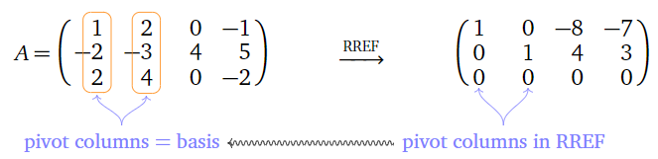
Basis and Dimension Ahmad Parsian
Q? How to compute a basis for the column space of a matrix A?
Facts:
i) The pivot columns of a matrix A form a basis for Col(A).
ii) The dimension of Col(A) is the number of pivots of A.
For a better understanding, look at the following

Slide 18
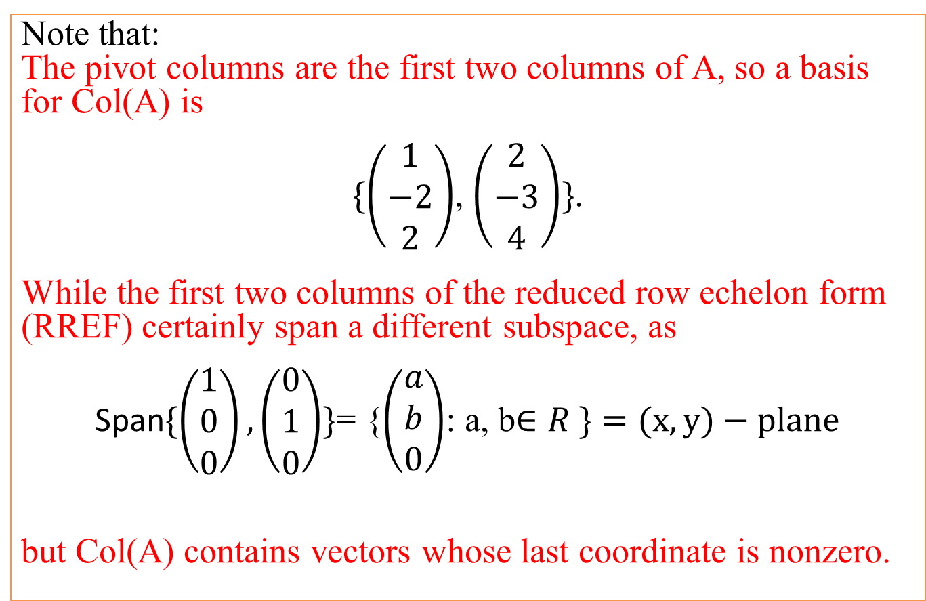
Basis and Dimension Ahmad Parsian
Note that:
The pivot columns are the first two columns of A, so a basis for Col(A) is
$\{\left(\begin{matrix}1 \\ −2 \\ 2\end{matrix}\right)$, $\left(\begin{matrix}2 \\ −3 \\ 4\end{matrix}\right)\}$.
While the first two columns of the reduced row echelon form (RREF) certainly span a different subspace, as
Span$\{\left(\begin{matrix}1 \\ 0 \\ 0\end{matrix}\right),\left(\begin{matrix}0 \\ 1 \\ 0\end{matrix}\right)\}$= {$\left(\begin{matrix}a \\ b \\ 0\end{matrix}\right)$: a, b$∈R \}=(x, y)−plane$
but Col(A) contains vectors whose last coordinate is nonzero.

Slide 19
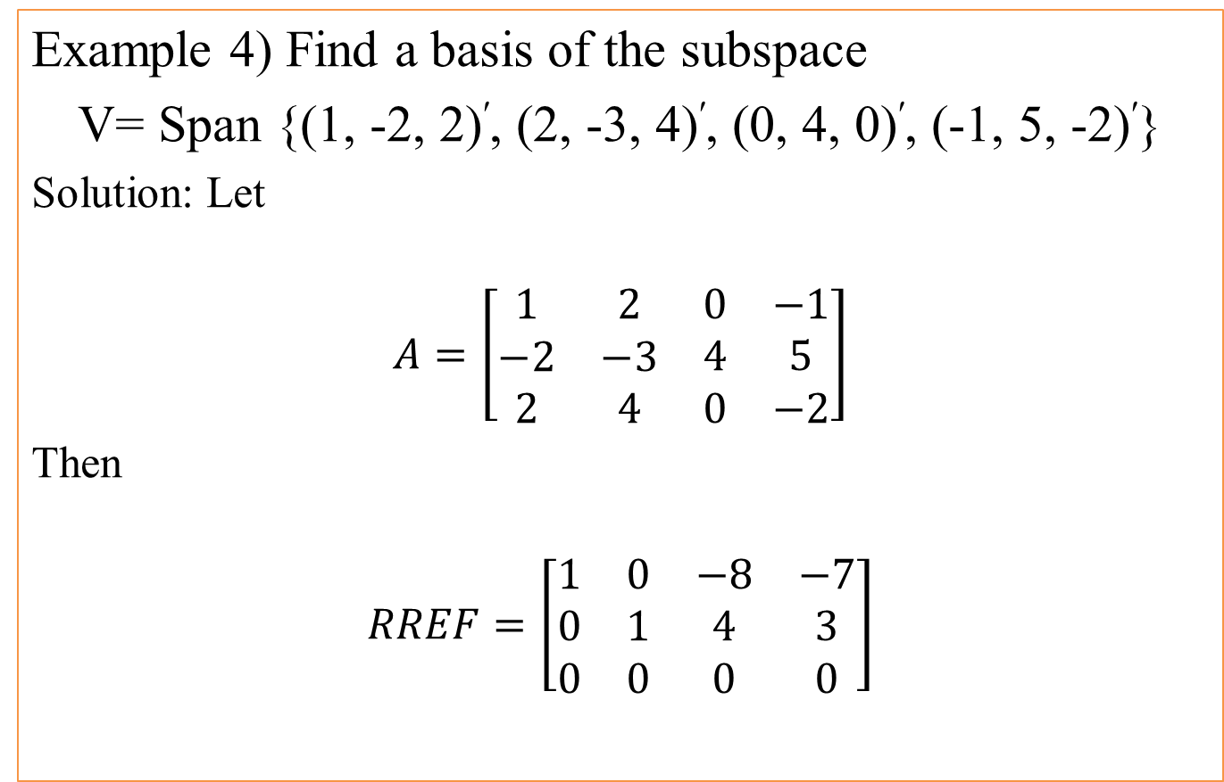
Basis and Dimension Ahmad Parsian
Example 4) Find a basis of the subspace
V= Span {(1, -2, 2)′, (2, -3, 4)′, (0, 4, 0)′, (-1, 5, -2)′}
Solution: Let
$$A=\left[\begin{matrix}\begin{matrix}1 & 2 \\ −2 & −3 \\ 2 & 4\end{matrix} & \begin{matrix}0 & −1 \\ 4 & 5 \\ 0 & −2\end{matrix}\end{matrix}\right]$$
Then
$$RREF=\left[\begin{matrix}\begin{matrix}1 & 0 \\ 0 & 1 \\ 0 & 0\end{matrix} & \begin{matrix}−8 & −7 \\ 4 & 3 \\ 0 & 0\end{matrix}\end{matrix}\right]$$

Slide 20
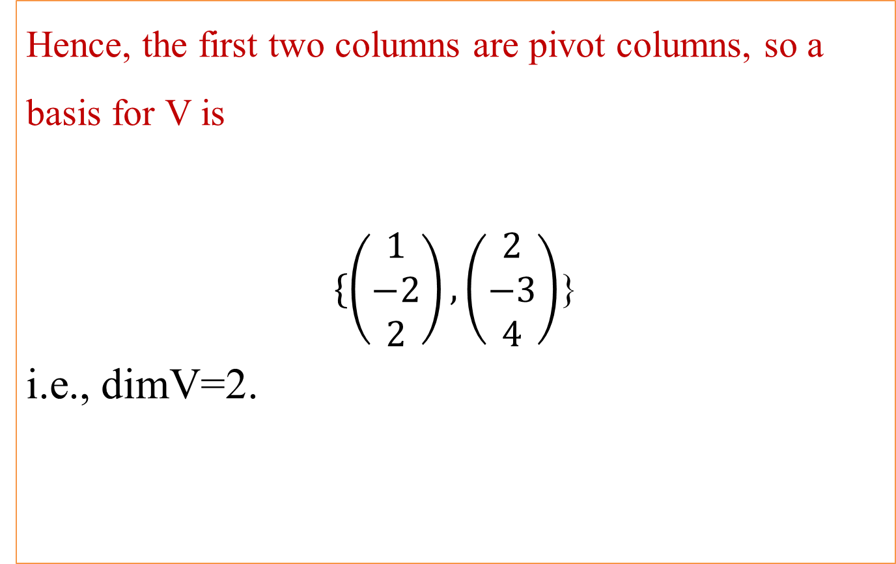
Basis and Dimension Ahmad Parsian
Hence, the first two columns are pivot columns, so a basis for V is
$\{\left(\begin{matrix}1 \\ −2 \\ 2\end{matrix}\right),\left(\begin{matrix}2 \\ −3 \\ 4\end{matrix}\right)$}
i.e., dimV=2.

Slide 21
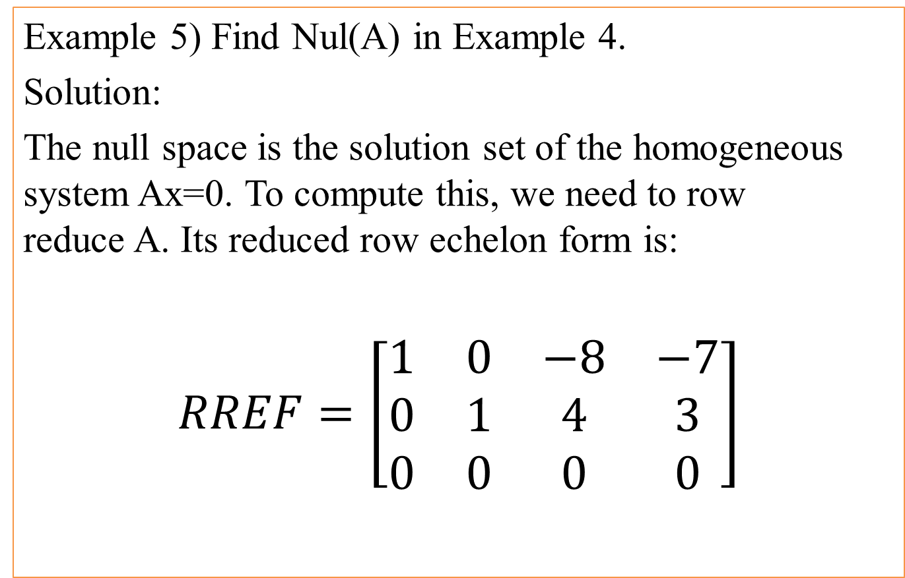
Basis and Dimension Ahmad Parsian
Example 5) Find Nul(A) in Example 4.
Solution:
The null space is the solution set of the homogeneous system Ax=0. To compute this, we need to row reduce A. Its reduced row echelon form is:
$$RREF=\left[\begin{matrix}\begin{matrix}1 & 0 \\ 0 & 1 \\ 0 & 0\end{matrix} & \begin{matrix}−8 & −7 \\ 4 & 3 \\ 0 & 0\end{matrix}\end{matrix}\right]$$

Slide 22
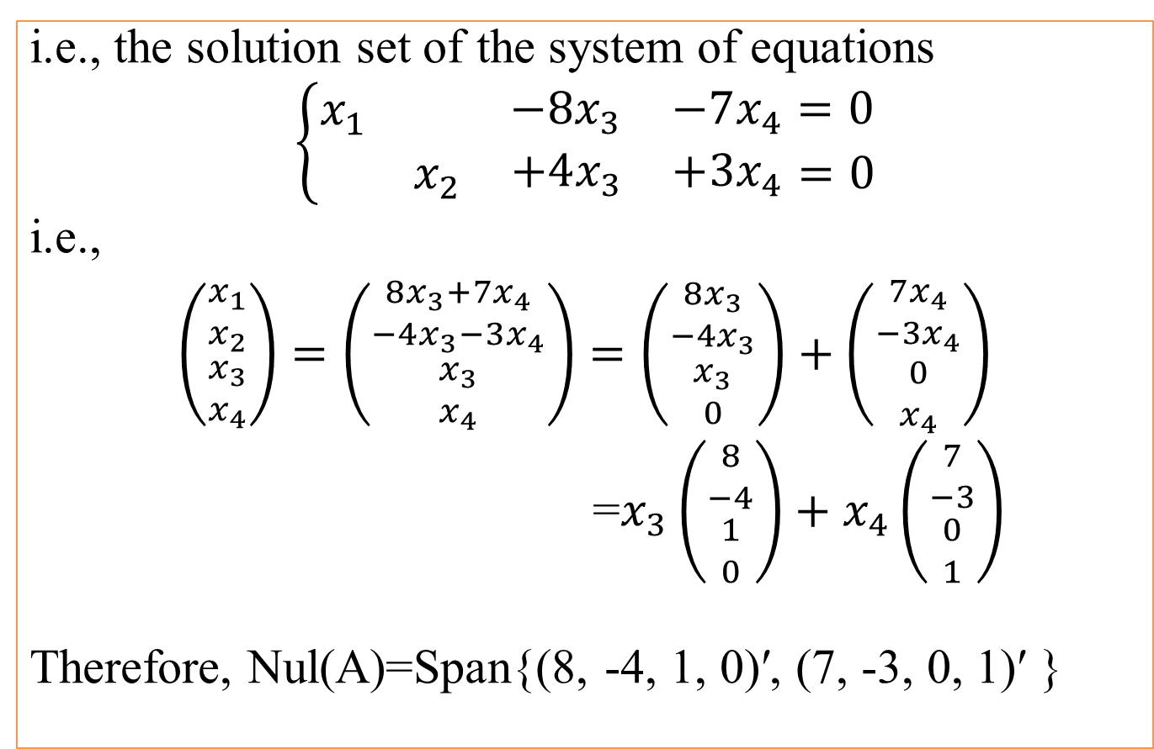
Basis and Dimension Ahmad Parsian
i.e., the solution set of the system of equations
$$\left\{\begin{aligned}\begin{matrix}x_{1} & \begin{matrix} & \begin{matrix}−8x_{3} & −7x_{4}=0\end{matrix}\end{matrix}\end{matrix} \\ \begin{matrix}\begin{matrix} & x_{2}\end{matrix} & \begin{matrix}+4x_{3} & +3x_{4}\end{matrix}\end{matrix}=0\end{aligned}\right.$$
i.e.,
$\left({\begin{matrix}x_{1} \\ x_{2}\end{matrix} \atop \begin{matrix}x_{3} \\ x_{4}\end{matrix}}\right)=\left({\begin{matrix}8x_{3}+7x_{4} \\ −4x_{3}−3x_{4}\end{matrix} \atop \begin{matrix}x_{3} \\ x_{4}\end{matrix}}\right)=\left({\begin{matrix}8x_{3} \\ −4x_{3}\end{matrix} \atop \begin{matrix}x_{3} \\ 0\end{matrix}}\right)+\left({\begin{matrix}7x_{4} \\ −3x_{4}\end{matrix} \atop \begin{matrix}0 \\ x_{4}\end{matrix}}\right)$
=$x_{3}\left({\begin{matrix}8 \\ −4\end{matrix} \atop \begin{matrix}1 \\ 0\end{matrix}}\right)+x_{4}\left({\begin{matrix}7 \\ −3\end{matrix} \atop \begin{matrix}0 \\ 1\end{matrix}}\right)$
Therefore, Nul(A)=Span{(8, -4, 1, 0)′, (7, -3, 0, 1)′ }

Slide 23
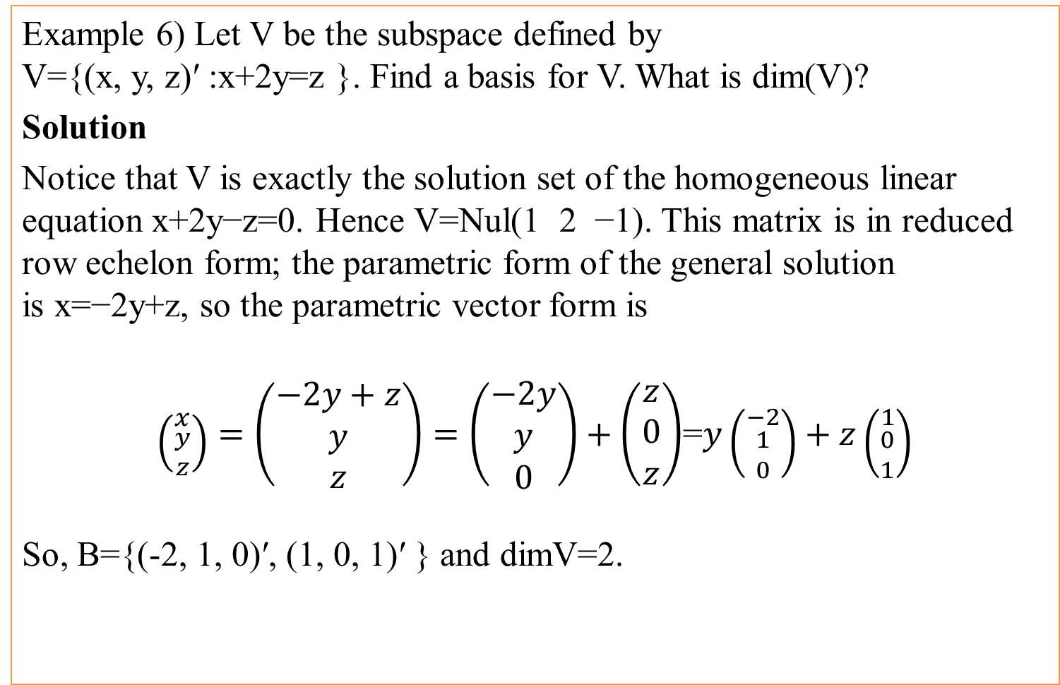
Basis and Dimension Ahmad Parsian
Example 6) Let V be the subspace defined by
V={(x, y, z)′ :x+2y=z }. Find a basis for V. What is dim(V)?
Solution
Notice that V is exactly the solution set of the homogeneous linear equation x+2y−z=0. Hence V=Nul(1 2 −1). This matrix is in reduced row echelon form; the parametric form of the general solution is x=−2y+z, so the parametric vector form is
$\left({x \atop \begin{matrix}y \\ z\end{matrix}}\right)=\left(\begin{matrix}−2y+z \\ y \\ z\end{matrix}\right)=\left(\begin{matrix}−2y \\ y \\ 0\end{matrix}\right)+\left(\begin{matrix}z \\ 0 \\ z\end{matrix}\right)$=$y\left({−2 \atop \begin{matrix}1 \\ 0\end{matrix}}\right)+z\left({1 \atop \begin{matrix}0 \\ 1\end{matrix}}\right)$
So, B={(-2, 1, 0)′, (1, 0, 1)′ } and dimV=2.

Slide 24
Basis and Dimension Ahmad Parsian
Fact:
Let V be a subspace of dimension k. Then:
i) Any k linearly independent vectors in V form a basis
for V.
ii) Any k vectors that span V form a basis for V.

Slide 25
Basis and Dimension Ahmad Parsian

Slide 26
Basis and Dimension Ahmad Parsian

Slide 27
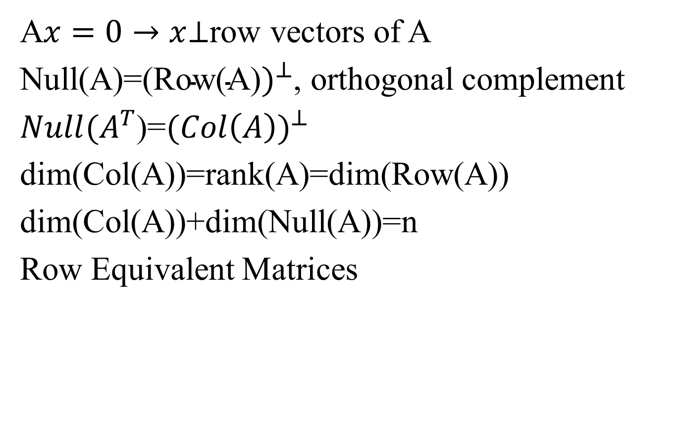
Basis and Dimension Ahmad Parsian
A$x=0→x$⊥row vectors of A
Null(A)=${\text{(}\text{Row}\text{(}\text{A}\text{)})}^{⊥}$, orthogonal complement
$Null(A^{T}$)=${(Col\left(A\right))}^{⊥}$
dim(Col(A))=rank(A)=dim(Row(A))
dim(Col(A))+dim(Null(A))=n
Row Equivalent Matrices

Slide 28
Basis and Dimension Ahmad Parsian

Slide 29
Basis and Dimension Ahmad Parsian

Slide 30
Basis and Dimension Ahmad Parsian

Slide 31
Basis and Dimension Ahmad Parsian

